Slide 1
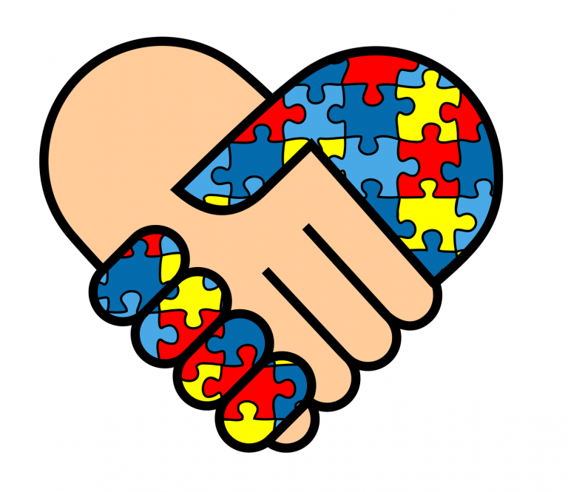
AUTISTIC ENCOUNTERS
By Lorie Coleman

Slide 2
Table of Contents
Overview Autism
Learn core symptoms
Break down of core symptoms
Common locations to encounter Autism
Growth in Autism

Slide 3
AUTISM OVERVIEW
Autistic Spectrum Disorder (ASD)
Neurological and Developmental Disorder
Early Childhood
No Concrete Causes
No cures
Last a Lifetime
Mild and Severe Cases
Information from Autism Speaks Organization

Slide 4
Core Symptoms
Social Communication challenges
Restricted Repetitive Behaviors
Sensory Issues
Information from Autism Speaks Organization

Slide 5
Social Communication Challenges
Eye Contact
Gestures
Spoken Language
Expressing Emotions
Personal Space

Slide 6
Restricted or Repetitive Behaviors
Rocking, spinning, or running back and forth.
Spinning, shaking, or flipping objects
lining up or touching objects
Need for set routines
Information from Autism Speaks Organization

Slide 7
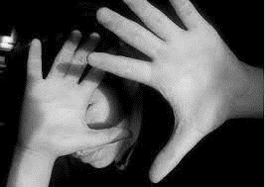
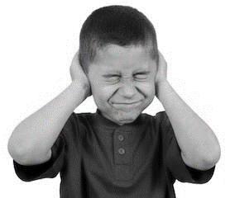
Sensory Symptoms
Site
Sounds
Smells
Tastes
Touch
Balance
Body Awareness

Slide 8
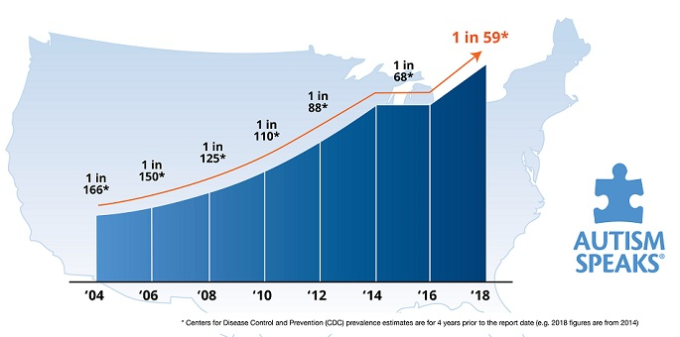
AUTISM PREVALENCE

Slide 9
Public Encounters
Grocery Store
Park
Doctors Office
School
Business

Slide 10
Work Cited
“What Is Autism?” Autism Speaks, 2018, www.autismspeaks.org/autism-facts-and-figures.
“Autism Youth Sports League” Autism Youth Sports League, 2010, http://www.autismyouthsportsleague.org/.
ST Louise, Joulie “Police Assaulted Autistic. Son.” https://www.courthousenews.com/parents-say-police-assaulted-autistic-son/. Accessed 20 December 2018.
“Autism Spectrum Disorder.” National Institute of Mental Health. December 2018, https://www.nimh.nih.gov/health/publications/autism-spectrum-disorder.
“Increase in Autism Prevalence.” Autism Speaks, 2018, https://www.autismspeaks.org/science-news/cdc-increases-estimate-autisms-prevalence-15-percent-1-59-children.

